Slide 1
Capstone Project
Airbnb Bookings Analysis - Hasnain Mazhar Rizvi

Slide 2
What Is Airbnb?
Airbnb, as in “Air Bed and Breakfast,” is a service that lets property owners rent out their spaces to travelers looking for a place to stay. Travelers can rent a space for multiple people to share, a shared space with private rooms, or the entire property for themselves.
The Airbnb Dataset Lists the number of spaces available with 16 columns describing various attributes.

Slide 3
Objective
1. Defining Problem Statement
2. Exploratory Data Analysis
3. Obtaining Critical Insights

Slide 4
Data Variables From AirBnb
Id- It provides a unique id to each listing in the dataset.
Name-It describes the property in a concise manner.
Host_id-It is used to ascertain the ownership of a certain individual
Host_name-It is the name of the property owner
Neighbourhood_group-It basically categorizes neighbourhood into five groups Bronx, Brooklyn,
Manhattan,Staten Islands and Queens
Neighbourhood-It designates the location of a property.
Lattitude-It Specifies the Lattitude of the property.
Longitude-It denotes the Longitude of the property.
Room_type-It classifies the type of property into Private_Room,Shared_Room and Entire_Apartment.

Slide 5
Data Variables From AirBnb
Price- It provides the price of each listed property.
Minimum_Nights-It gives the minimum night one needs to pay for in the property.
Number_of_reviews-It is used to ascertain the number of reviews received by a property.
Reviews_per_month- It denotes the number of reviews per month.
Calcuated_host_listings_count- It corresponds to the number of properties hosted by the unique host_id
Availability_365- The number of days the property is available in a year.

Slide 6
Data Cleaning
When we started to explore the data is very essential to do the data cleaning before go ahead to analysis part.
For that we use
df.isnull().sum()

Slide 7
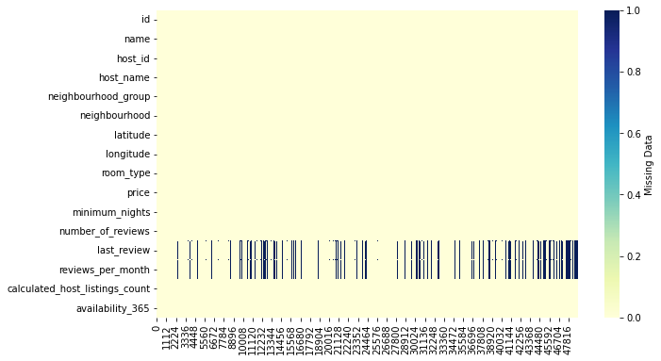
Data Cleaning Visualization

Slide 8
Problem Statements :
1. Which has Most Listing in AirBnb NYC
2. Which have More Listing in Each Neighborhood Groups
3. Expensive Neighborhood Group (Location of NYC)
4. Most Listing in Each Room
5. Most Listed Neighborhood (Area of Location in NYC) (ex : Kensington, Midtown, Harlem etc..)
6. How Price is correspond to minimum nights
7. Number of Reviews
8. Most Densed Places According to Latitude and Longitude

Slide 9
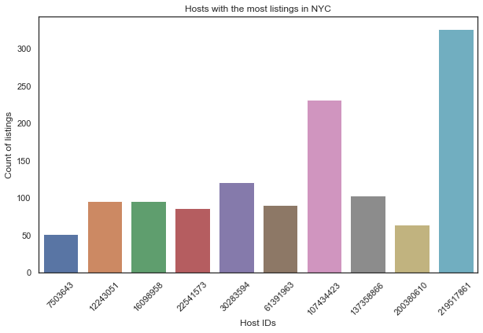
Exploratory Data Analysis
1. Which has Most Listing in AirBnb NYC

Slide 10
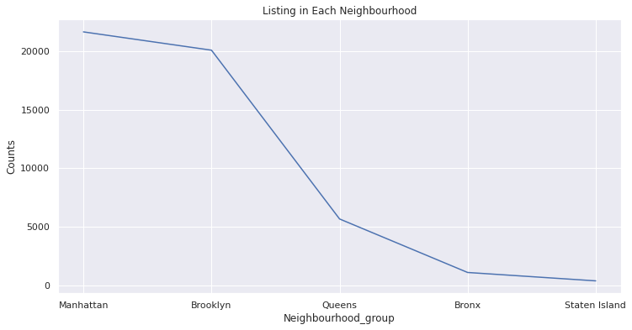
Exploratory Data Analysis
2. Which have More Listing in Each Neighborhood Groups

Slide 11
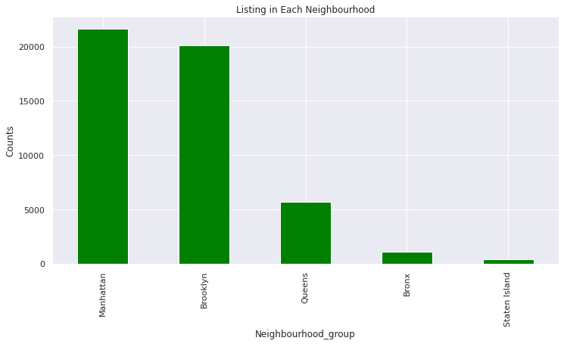
Most Listing using matplotlib barplot

Slide 12
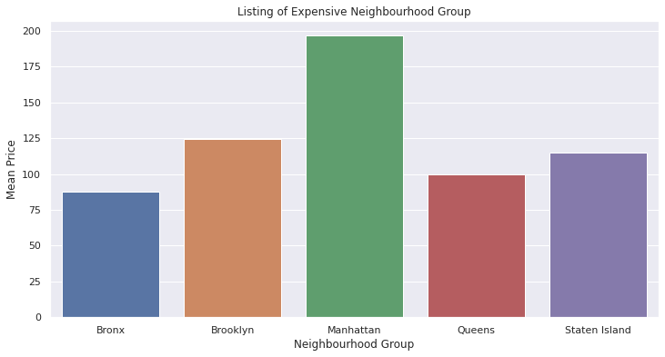
Exploratory Data Analysis
3. Expensive Neighborhood Group (Location of NYC)

Slide 13
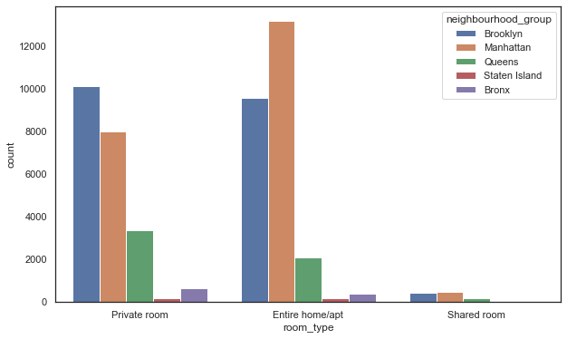
Exploratory Data Analysis
v4. Most Listing in Each Room

Slide 14
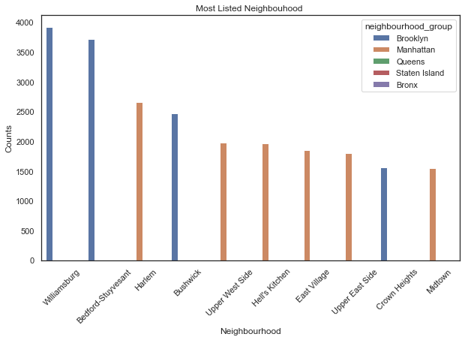
Exploratory Data Analysis
5. Most Listed Neighborhood (Area of Location in NYC) (ex : Kensington, Midtown, Harlem etc..)

Slide 15
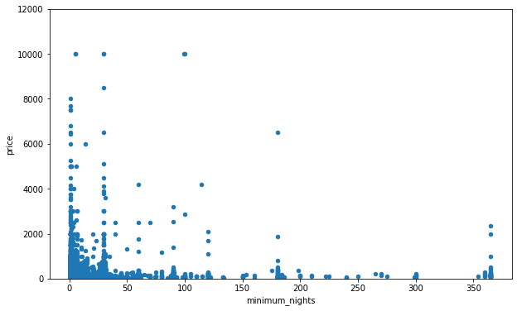
Exploratory Data Analysis
How Price is correspond to minimum nights

Slide 16
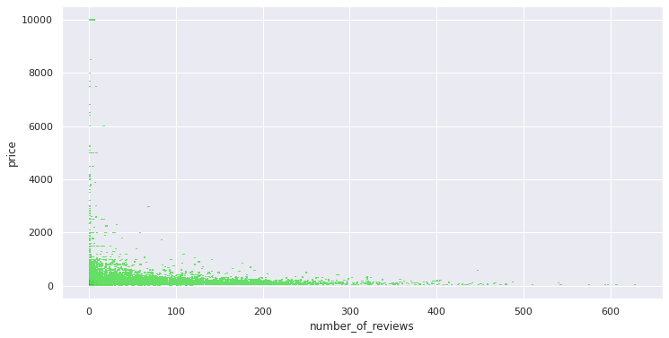
Exploratory Data Analysis
6. Number of Reviews

Slide 17
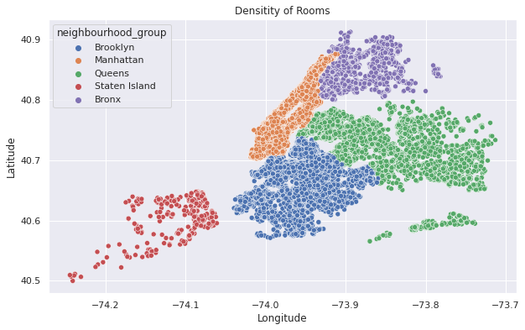
Exploratory Data Analysis
7. Most Densed Places According to Latitude and Longitude

Slide 18
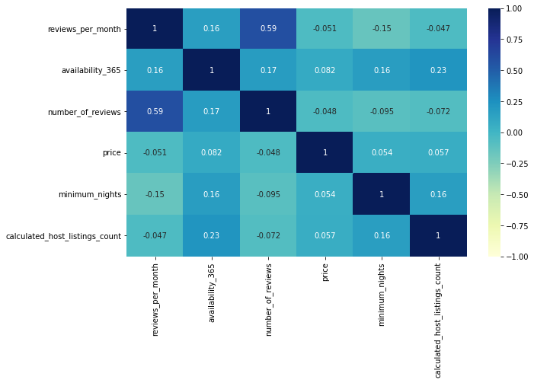
Exploratory Data Analysis
Correlation Heatmap

Slide 19
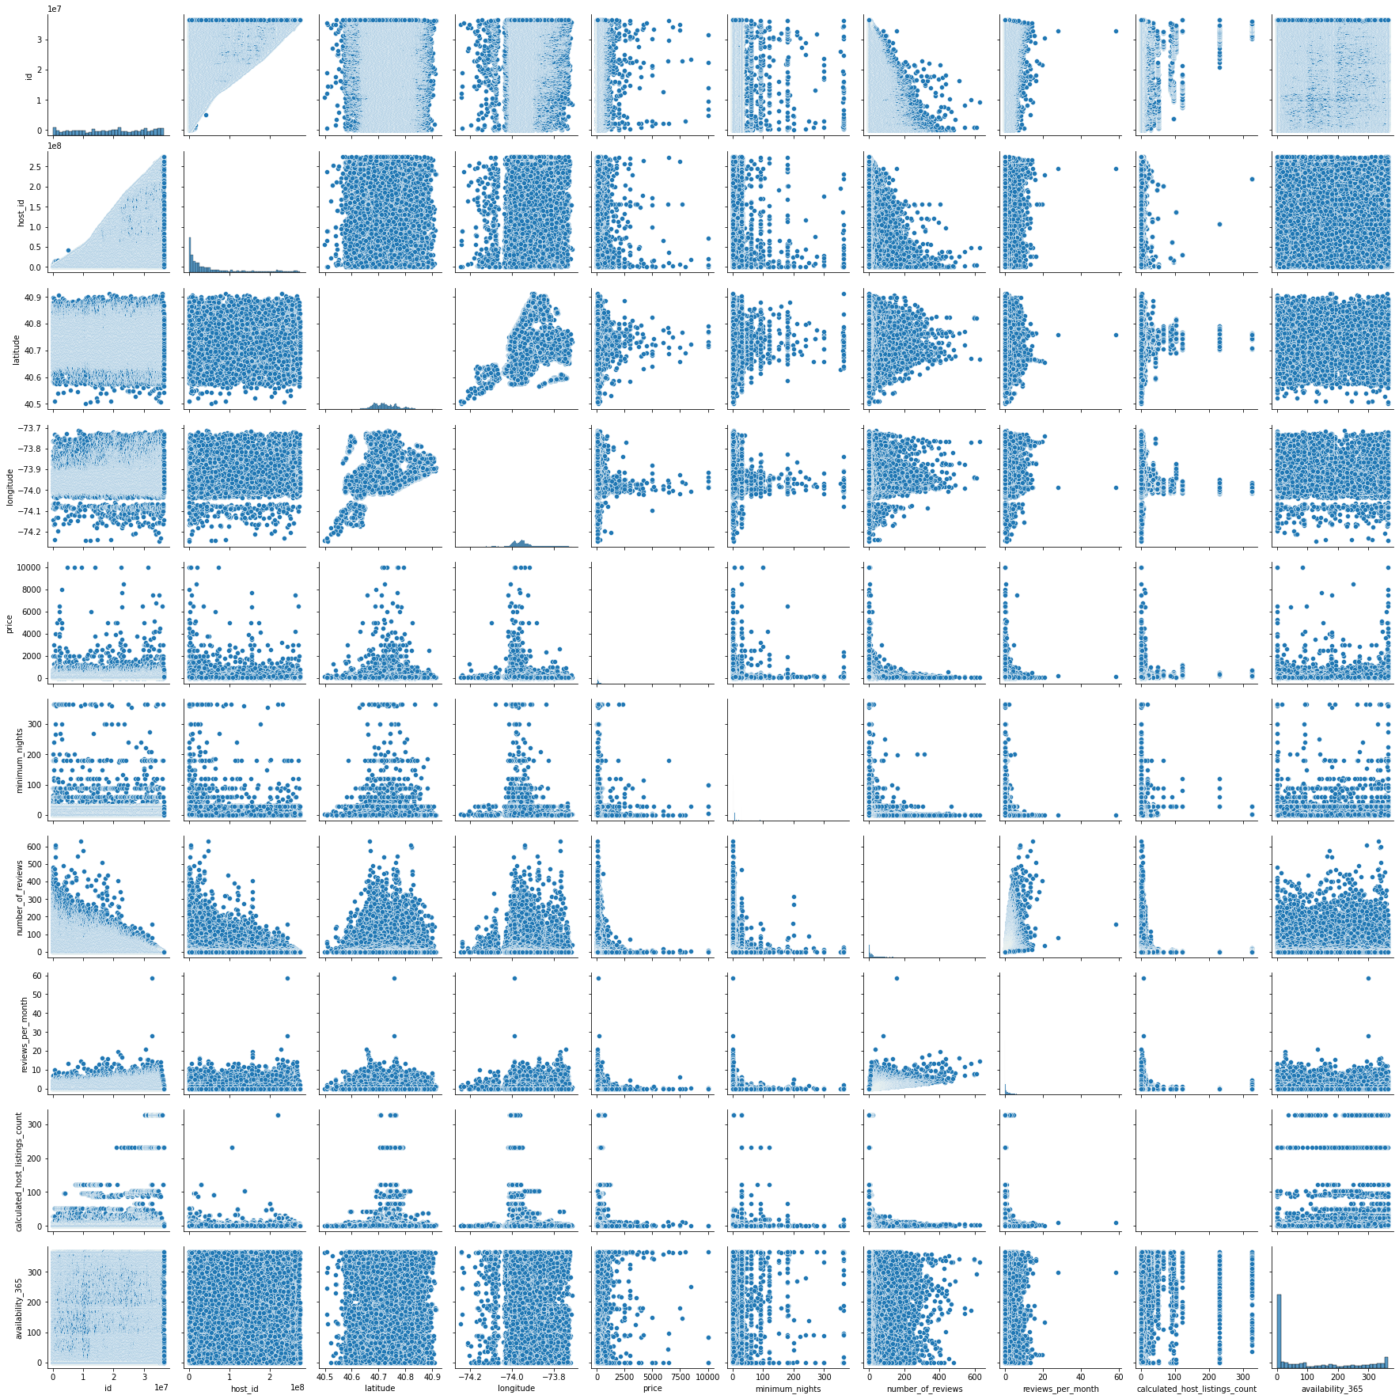
Pair Plot

Slide 20
Conclusions
1. host_id reveals that some host have a huge number of property ownership above 300.
2. The Majority of the listings are located in Manhattan and Brooklyn whereas Bronx and Staten Island have a miniscule share.
3. Manhattan is the most expensive neighbourhood_group followed by Brooklyn Staten Island Queens and Bronx.
4. Most Listings offer Entire home followed by Private Room and Shared Room
5. Brooklyn offers nearly the same number of private rooms and entire home whereas Manhattan offers highest number of entire homes followed by private rooms.
Notes:
host_id reveals that some host have a huge number of property ownership above 300.
2. The Majority of the listings are located in Manhattan and Brooklyn whereas Bronx and Staten Island have a miniscule share.
3. Manhattan is the most expensive neighbourhood_group followed by Brooklyn Staten Island Queens and Bronx.
4. Most Listings offer Entire home followed by Private Room and Shared Room
5. Brooklyn offers nearly the same number of private rooms and entire home whereas Manhattan offers highest number of entire homes followed by private rooms.

Slide 21
Conclusions
6. Listing of shared room is very little and staten islands and bronx offer very few shared rooms.
7. Williamsburg,Bedford-Stuyvesant and Harlem are the most listed neighbourhood.
8. Brooklyn and Manhattan has the majority share of listings.

Slide 22
Thank you

